Slide 1
Study on Sensing and Monitoring of Sewing Machine for Textile Stream Smart Manufacturing Innovation
M2VIP 2017
2017. 11. 22.
Ph.D Jae Yong Lee
Manager : Mechatronics Team
KOTMI : Korea Textile Machinery Convergence Institute
Notes:
Hi, ladies and gentlemen, nice to meet you.
I am glad to be here to present my research items in this conference.
I am working at KOTMI(Korea Textile Machinery Convergence Institute) in Republic of Korea, that is South Korea not North Korea.

Slide 2
1. Definition and necessity of technology development
▶▶ Background of Technology Development
Changes in consumer trends due to personalization and digitization by the development of on-line distribution market
The emergence of long-tail market by diversification and small quantity of products combined with population increase
Development of smart factory construction technology to improve the productivity of manufacturing factory with ICT-based informationization and automation technology
Smart Factory
CPS : Cyber-physical systems → Core Technology
Process/Machine/Equipment Automation → Element Technology
IoT : Internet of things → Element Technology
Various data required for production are transmitted through CPS and a smart plant is constructed by configuring an optimized platform for the production system.
The Smart Factory controls and manages the entire production process and enables product optimization
(source : KEIT PD(2015-4) issue)

Slide 3
1. Definition and necessity of technology development
▶▶ Necessity of technology development
Production efficiency can be increased through improvement of workability of factory and quality control and reduction of defects
Proper inventory management and productivity improvement through bottleneck elimination by real-time management of process
Expansion of production capacity by internal control and external collaboration through system platform
Equipment
Product
Quality Management
Workability Improvement
Fluctuation Control
Quality Improvement
Defect
Reduction
Production Efficiency Increase
Process Management
Real Time Management
Merge
Control
Flow
Improvement
Working Time
Reduction
Productivity Increase

Slide 4
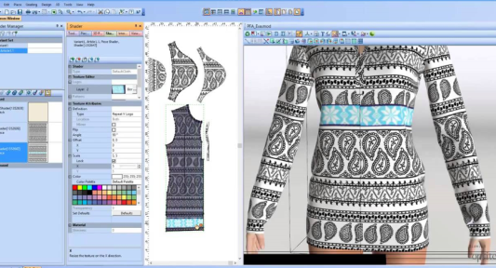
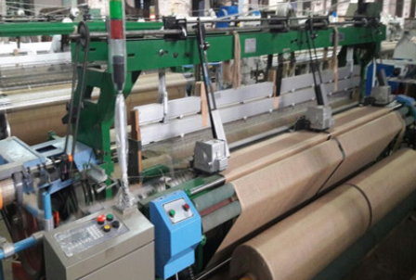


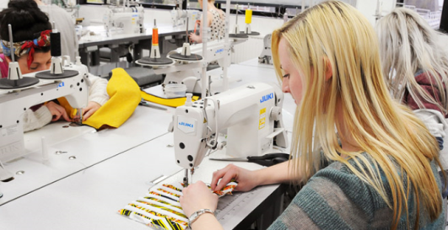
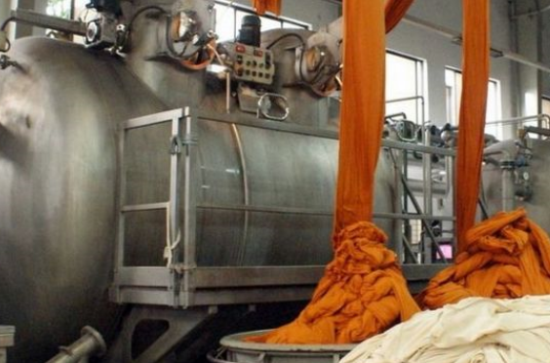
1-1. Definition and necessity of technology development
▶▶ Problems of existing textile product production process
The production of existing textile products is based on estimating the sales volume in line with the season rather than the opinions of consumers.
Inventory accumulation due to overproduction and lack of product diversity are inevitable to respond to customer preferences
Order - Design - Fabric production - Dyeing, finishing - Sewing
Information on products between streams is not linked and timely production and delivery can not be adjusted

Slide 5
1-1. Definition and necessity of technology development
▶▶ Benefits of Improved Textiles Production Process
CPS-based textile product Smart Factory
  Analyzes sales volume trend and enables high-level management through production of small amount of repeats in the right time
  Timely production and supply by sharing sales / inventory / schedule information among streams
  Productivity increase due to reduced inventory and reduced defects

Slide 6
1-1. Definition and necessity of technology development
▶▶ 현재 섬유생산 현황
사진…. 편직, 염색, 봉제 공정 사진…. 개선 필요성 설명

Slide 7
1. Definition and necessity of technology development
▶▶ Definition of Technology Development
Implement Cyber physical system (CPS) that can manufacture products using virtual design information
→ Development of 2-Way CPS-based manufacturing process innovation system
  Innovative manufacturing system capable of timely production and short delivery of multi-product small lot products
  Establishment of a system capable of producing high productivity products through product quality control and process flow management

Slide 8
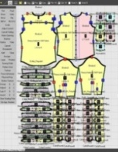
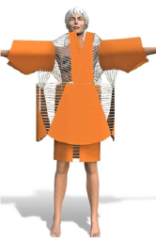
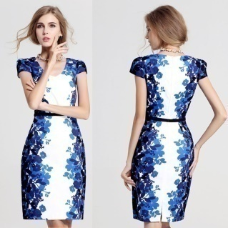
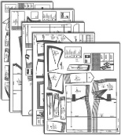
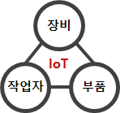
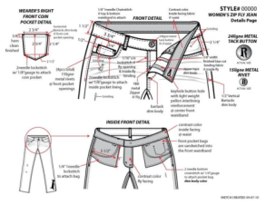
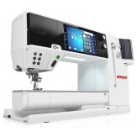
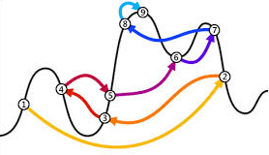




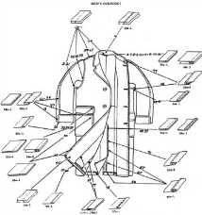

1. Definition and necessity of technology development
<Pattern Design>
Design
Manufacturing
<Quality Control>
Product
CPS
Product
Quality
<Inspection Spec>
< Dimension,
Material >
<Sewing Spec>
[ Product Simulator ]
[ Product Parts ]
CPS
Machine
<Work Spec>
Worker
Equipm-ent
[ Process Simulator ]
[ Manufacturing ]
Process
CPS
Process
Flow
<Technical Spec>
< Material, Method,
Men, Machine >
<Process Control>
<Process Spec>
<Co-work Factory>
<1 person Factory>

Slide 9
1. Definition and necessity of technology development
▶▶ CPS configuration of smart manufacturing system
Product Data
Process Data
Cyber
space
Simulator
(Design)
Product Virtualization
Simulation
Process Virtualization
Simulation
PDM
Extension
Product Design
Modules
Order Management
Process Design
Modules
Extended
PDM
(Reference)
Feedback
Product Configure
4M Recourse
Process Layout
Product History
Inventory
Process Routing
POP Extension
Physical
space
Product Data
Modules
Point of Production
Modules
Extended
POP
(Command)
Product Spec
Setting
Process Sequence
Operation Spec
WIP Inventory
Process Control
Quality Acquisition
Machine Controller
Event Monitoring
IoT
Machine
(Operation)
Actuating
Feedback
Sensing
(Static)
(Dynamic)
※ PDM(Product Data Management), POP(Point of Production)

Slide 10
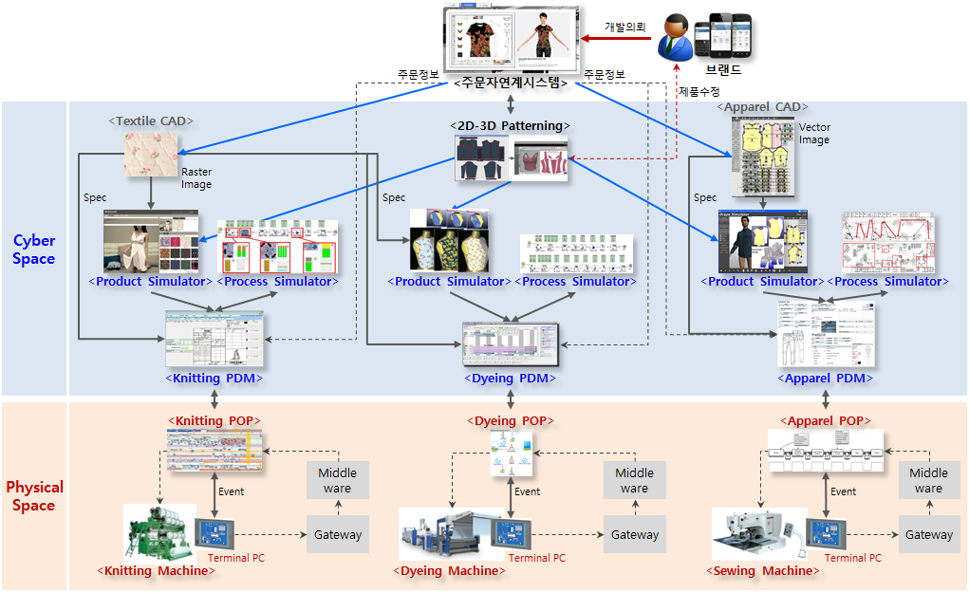
2. Goals and Contents
▶▶ Establishment of smart production system for collaboration between streams capable of producing high productivity products
Develop
Request
Order Information
Order Information
Customer-Linked System
Brand
Product Modify

Slide 11
2. Goals and Contents
CPS : Cyber-physical systems
: The base system that products designed in virtual space are commercialized in physical space
Product simulator for CPS by 2D-3D patterning technology
Process simulator for CPS for process optimization design
Product information management (Extended-POP) system for CPS that manages design information
Stream-to-stream ordering system that enables the production management of the purchaser
Process‧Machine Automation
: Automation of factories based on mechatronics and robotics technology
Production event detection (sensing function) such as production conditions, inventory change
Control function to make decision based on sensed production information
Actuating function that reflects judgment result to production site
IoT : Internet of things
: Communication technology for delivering CPS standard data packets to equipment
Virtual-network infrastructure technology for processing all information in the physical world
Data interface technology that processes and processes information and fuses technology

Slide 12

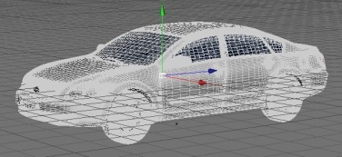
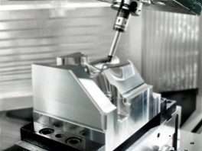
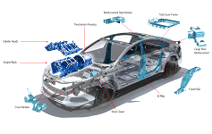



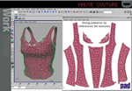
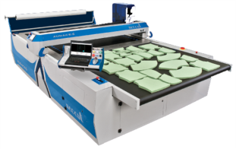
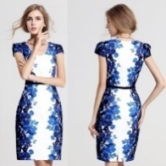

3. Core Technology Development (Product CPS)
▶▶ Development of Product CPS Technology for Smart Factory
Product CPS manages product specifications →→ Implementation of quality and functionality, product identity and reproducibility
  Converting 'product design' information in the design area to 'fabrication' information in the manufacturing area
  Dimension data of prototype is confirmed through 3D simulation based on CAD data
  Converting Dimension and Material property to CAM information through PDM system and transfer to the POP system
Product CPS provides real-time specifications of final products through Prototype's simulation
CPS (Cyber-Physical System)
< CAR Industry >
< Fabric & Fashion Industry >
Cyber Space
Physical Space
Order
Product Design
Product
CPS
Fabrication
Product
Process Design
Process
CPS
Assembly

Slide 13


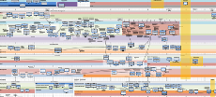
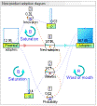
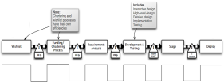




3. Core Technology Development (IoT & Automation)
▶▶ Development of IoT and Automation technology for Smart Factory
Development IoT / M2M technology to enhance connectivity between unit processes and equipment
  Application of IoT gateway for 4M data processing
  Development of large-capacity real-time processing middleware for large-capacity IoT data transfer processing
  Development of IoT standard protocol applied device for IoT scalability
Development standard data packet for textile fashion stream CPS
  Apply XML format for dimension and 4M data conversion between PDM and POP system
  Standard data set definition of ‘product design’ and ‘process design’ information
POP-based smart process control technology development
  Automation of equipment based on Dimension과 4M data
  Development of sensing, actuating and control technology for process and equipment
Physical
Space
<Knitting POP>
<Dyeing POP>
<Apparel POP>
Middle
ware
Middle
ware
Middle
ware
Event
Event
Event
Gateway
Gateway
Gateway
<Knitting Machine>
Terminal PC
<Dyeing Machine>
Terminal PC
<Sewing Machine>
Terminal PC

Slide 14
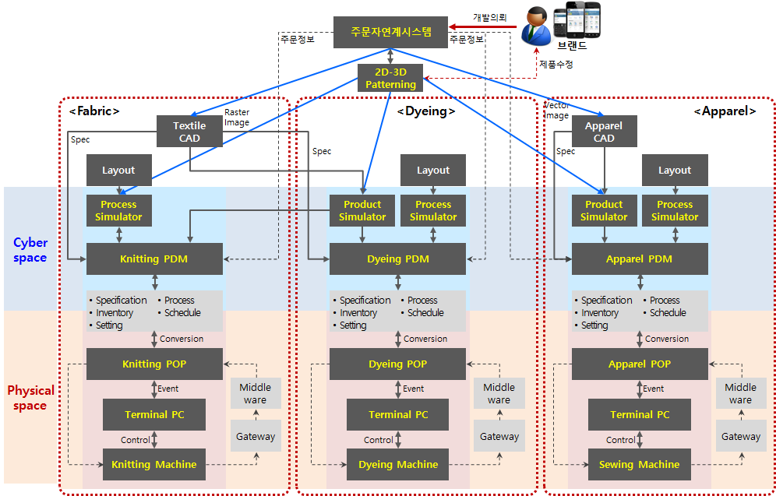
4. Total Plan
▶▶ Connected Smart Manufacturing Innovation Technology for Stream-to-Stream Collaboration
Develop
Request
Order Information
Order Information
Brand
Product Modify

Slide 15
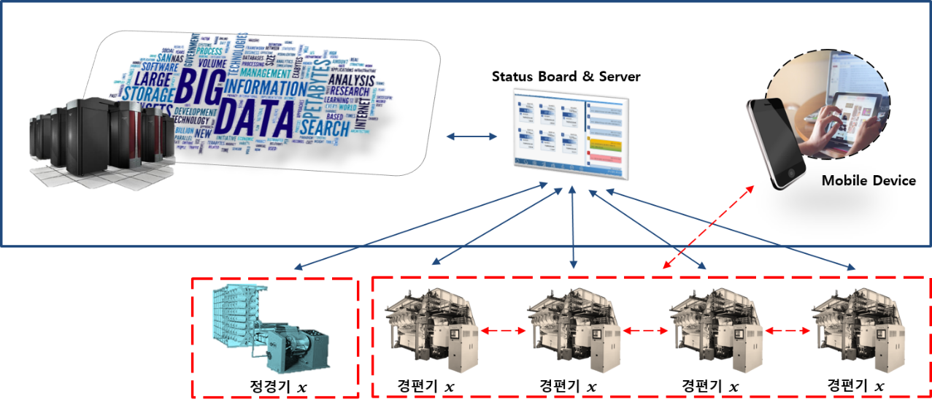
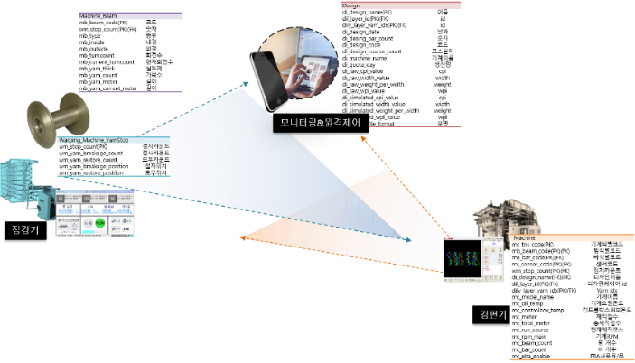
5. Fabric Part Smart Factory
▶▶ Fabric Stream Structure Design (Fabric) : Warp Knitting Machine
Warping machine
Warp knitting machine
Warp knitting machine
Warp knitting machine
Warp knitting machine
  Design of production event detection function, sensor information analysis, information property design
  Design of decision-making and performance functions based on production information

Slide 16
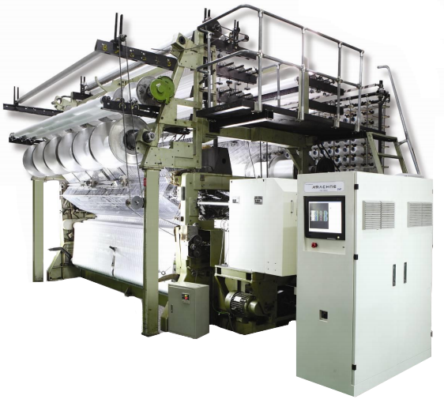
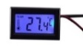



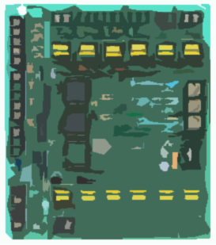

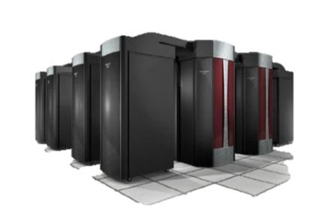
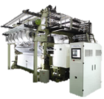




5. Fabric Part Smart Factory
POP & Server
Convenient module
extension setup
Temperature Sensor
Humidity Sensor
Motor Temp. Sensor
Control Temp. Sensor
Thread Status
Vibration Status
Shock Sensor
Smart Factor Integrated
Sensor Information
Acquisition Module
Notes:
① 개발 내용 및 범위
[Knit CPS용 POP시스템의 상세기능 설계 및 시스템 기능 구현]
[POP단말모듈] 생산현장 POP단말기용 현장관리 및 생산정보 관리 모듈개발
- 정경기/경편기 생산 작업지시 및 작업표준 정보 조회 기능 설계 및 개발
수집 데이터의 관리 및 분석을 위한 데이터전송 서버모듈 개발
[Middleware] Machine가동정보 수집 및 분석모듈개발
- 정경기/경편기 가동변수 정보분석 및 수집
- 정경기/경편기 머신컨디션 데이터 수집 디바이스 설치 및 데이터 전송
[Knit CPS용 모니터링 시스템 설계 및 시스템 구현]
[모니터링 시스템 설계] 기본 설계 및 생산관리 모니터링 모듈개발
- 정경기/경편기 가동변수 모니터링 및 상태 확인 기능
- 사용자의 생산 스케쥴 설정 및 확인 기능

Slide 17
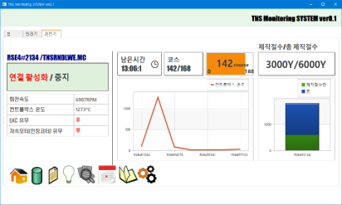
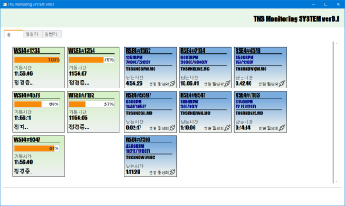


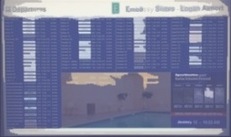
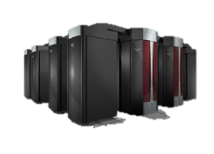
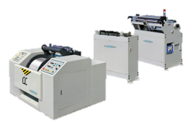
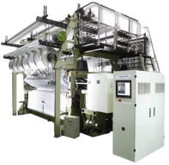
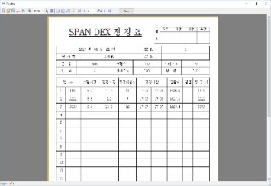
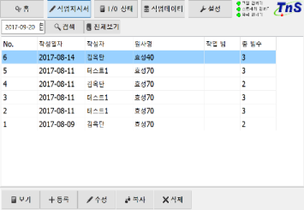
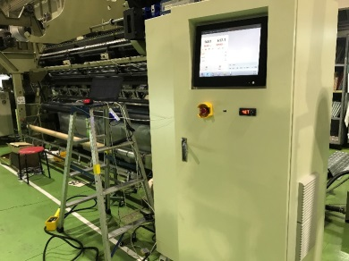
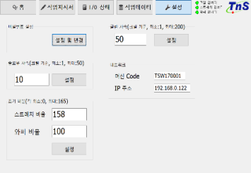
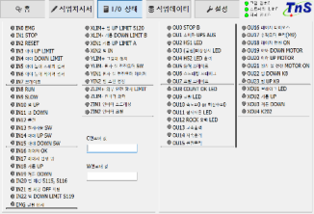
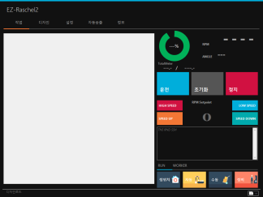
5. Fabric Part Smart Factory
< Monitoring status screen under development >
Check the status of the machines in the factory / warp machine connected to the factory in real time.
The database is stored in advance and the machine is able to determine whether it is abnormal.
In the future, you can check the status of the equipment in advance and prevent malfunctions in advance.
PDM
(Data Product Company Transferring)
Status Board & Server
<Server>
Encrypt the information of factory's equipment status and production data, and deliver it in JSON form
Warping Machine
Tricot Machine
< Sensor board of equipment >
Receive the sensing value of sensor module of each equipment and record.
(Later analysis of sensing value, improvement of production sustainability)
<Warp Knitting Status Display >
Setup >> Register the equipment using the machine code and IP address of the network, and receive the information such as the status of the equipment and the production amount based on the code of each installed equipment

Slide 18
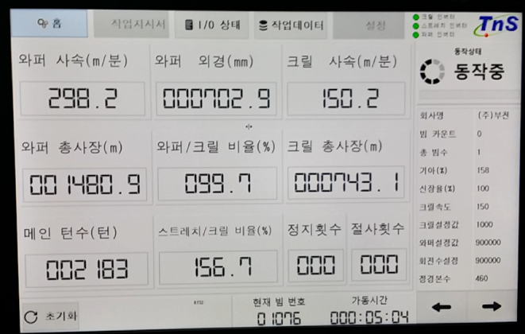
5. Fabric Part Smart Factory
▶▶ Warp Knitting Machine Status Monitoring Display

Slide 19
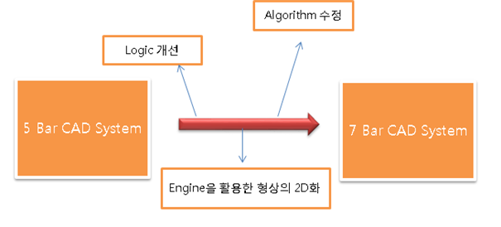
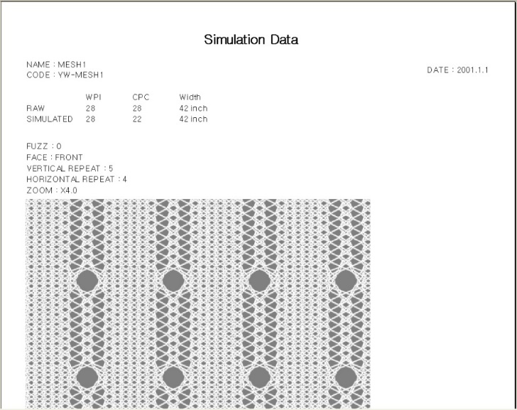
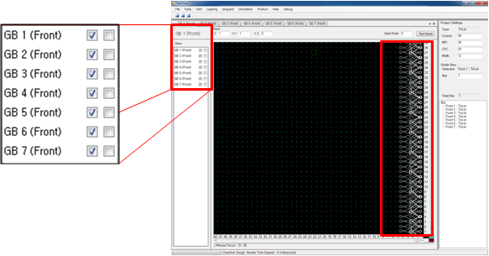
5. Fabric Part Smart Factory
▶▶ Product CAD (Fabric)
Requirements Analysis and Basic Structural Design of CAD System for Knit DDM
∘ Production data collection for knitting
∘ Investigate and collect technical information on unimplemented 7Bar warp knitting logic & devices
∘ Data collection and structural design required for CAD development
∘ Warp knitting logic design
Algorithm Modify
Logic Modify
2D transformation of geometry using Engine
< Knit CAD System TexTricot Design Table >
< CAD System Structure map of warp knitting for CPS >

Slide 20

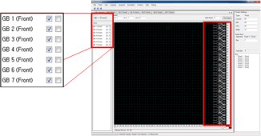
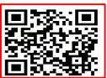
5. Fabric Part Smart Factory
▶▶ Extended PDM (Fabric)
Warp knitting CAD Design Data PDM System(Product CPS) and TexDDM(Process CPS) basic structure
∘ Fabric design simulation, design data extraction and XML Parsing in CAD
∘ Database structure of XML file structure, table design and connection establishment according to structure, construction
∘ 7 bar warp knitting design CAD structure design
∘ Data reading in the linked Web, storage and output in the built database
Product CPS
Process CPS
Yarn Management
Warp Management
Design Data
knit Design CAD
Sewing
Stream
7Bar CAD Structure Design
Yarn inventory
Design
Data
TEXDDM
Design Data Management
Work Order
Dyeing
Stream
knitting and design information
Production schedule by device, progress information
In/Out Info.
Producer, color information,
Material information,
Simulation images etc.
Online mapping solution
Production progress information
Out
Design & Yarn information
Fabric Delivery
Planning of finished product dictionary through simulation image in QR Code

Slide 21
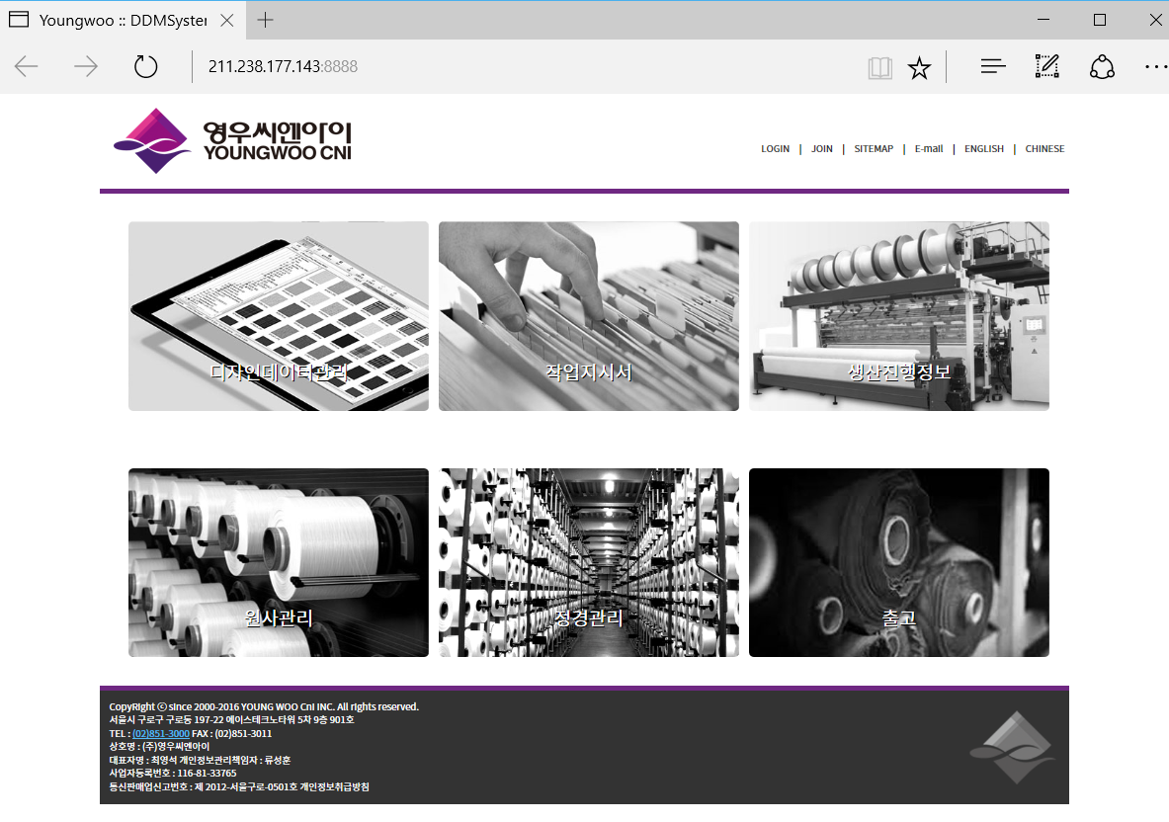


5. Fabric Part Smart Factory
▶▶ Extended PDM (Fabric)
Process CPS configuration and web implementation for warp knitting
∘ Classified as 6-step process
∘ Parsing and web implementation of CAD design data
∘ Generate QR Code for Web Parsing of Design Data
<경편 CAD Design Data PDM 시스템 Web Service TexDDM Main Page>

Slide 22
5. Fabric Part Smart Factory
▶▶ Extended POP (Fabric) :
Knit CPS POP System Basic Structure Analysis & Design
Work Order
Integrated Sensor Module
Beam Warping Event
Warp Knitting Machine
Beam Information
Work Status
EL Information
EBC Information
Warp Machine
PDM
POP
  POP backbone access, authentication algorithms and encryption
  Category and design for collaborative information of POP system for CPS
  Data packet design for collaborative information of PDM system for CPS

Slide 23










6. Dyeing Part Smart Factory
PDM System
POP System
Order Information Management
Prescription Information Management
Fabric Management
Production Management
Work Instruction
Process Monitoring
Raw Fabric
PDM/POP
Server
POP System
POP System
Process Management
Touch
Screen PC
Touch
Screen PC
Touch
Screen PC
Fabric Length Info.
Temp/pH Info.
IoT Device
RFID Card
Reader
Temp/pH Info.
IoT Device
RFID Card
Reader
RFID Card
Writer
RFID
Card
RFID
Card
RFID
Card
Rotary
Encoder
Temp. Sensor
Temp. Sensor
pH Sensor
pH Sensor
Unwinding
Scouring
Preprocess
Notes:
Scouring : 정련… 풀먹인거를 녹여주는 작업

Slide 24



7. Apparel Part Smart Factory
▶▶ Process Simulator (Fabric)
<Object Performance>
Performance Index
- Manufacturing Lead Time
- Work-in-Process
- Machine Utilization
- Throughput
- Capacity
- Flexibility
- Performability
- Quality
<System Structure>
<4M Data Stureture>
<Petri-Net modeling Structure>

Slide 25

7. Apparel Part Smart Factory
▶▶ Process Simulation (Sewing)
Sequence of process is important.
▶▶ Simulates the sequence of the following actions according to the type of LOT in the queue
Man
Method
Machine
Parts
(Material)
Operation
Parts
(Material)
Order
︙︙
In-buffer
Out-buffer
Start Event
End Event
Process Simulation by 4M Data

Slide 26







7. Apparel Part Smart Factory
▶▶ Development of manufacturing process design technology for apparel production
Performance modeling based on process design parameters
Developed a parameter-based process simulator (What-if Process Simulator)
Development of performance index modeling and analysis / evaluation model
<Analysis of garment sewing process>
<Analysis of process organizing efficiency>
<Garment sewing layout>
<Routing model>
<Process Spec>
[ Process Simulator ]

Slide 27



7. Apparel Part Smart Factory : Sewing Machine
▶▶ Smart Sewing Machine (Apparel)
Working Event Detection H/W Structure Figure
POP Terminal
RFID reader
Under Thread Sensing System H/W Development
4 inch touch screen
Under thread bobbin winder part
Prevention of under thread tangling
Under thread residual sensing part
Under thread bobbin rotation speed sensing part

Slide 28






7. Apparel Part Smart Factory : Sewing Machine
▶ Apparel Stream용 스마트 제조 시스템 설계(봉제기)
▶▶ Smart Machine (Apparel)
Under thread residual amount and bobbin rotation speed sensing acquisition data
Under thread automatic measurement mode | ◎ Under thread bobbin residual detection value setting ◎ Under thread residual detection
Under thread manual measurement mode | ◎ Detecting the amount of bobbin bobbin detected in the current operation
Under thread rotation measurement mode | ◎ Under thread bobbin rotation number sensing
Error status mode | ◎ Under thread residual error display
 | ◎ Bobbin rotation error display
Under thread detection sensing system UI

Slide 29
7. Apparel Part Smart Factory : Sewing Machine
▶▶ 대희 논문 내용 추가

Slide 30
7. Apparel Part Smart Factory : Sewing Machine
▶ Apparel Stream용 스마트 제조 시스템 설계(봉제기)
▶▶ 대희 논문 내용 추가

Slide 31
10. 계획변경 요청사항
▶▶ 스트림별 Process simulator의 개발을 단일 시뮬레이터로 통합
공정 시뮬레이션은 다품종소로트 제조공정을 해석하기 위해 이산현상시스템(Discrete event system)을
Petri-Net으로 모델링하는 방법론을 적용
  스트림(Apparel, Dyeing, Fabric)의 Process를 모델링하는 방식은 동일
  스트림별로 4M(Machine, Men, Material, Method)에 따른 시뮬레이션 결과가 별도 제어방식으로 나타남
  시뮬레이션 결과에 따른 Process controller는 스트림별로 구성됨
  각 스트림별 Process controller가 4M data를 사용하여 공정을 제어하는 구조
→ 스트림별로 Process simulator를 설계하는 것과 단일 Process simulator로 설계하는 것이 동일
→ 스트림별로 분리된 형태로 작성된 내용을 단일 Process simulator의 개발 내용으로 통합
▶▶ Apparel & Dyeing product simulator의 개발을 단일 시뮬레이터로 통합
Product simulator는 섬유 소재의 색상과 물성에 따른 의류 제품을 가상으로 모사하여, 디자이너의 요구에
따른 제품 생산이 가능하도록 지원하는 Application임
  Apparel에서는 원단의 물성 및 구조에 따른 Drape와 봉제 구조를 모사하여 제품을 결정
  Dyeing에서는 원단의 색상 및 구조를 모사하여 Color 값을 결정
  염색 스트림의 Product simulator는 의류를 모사한 Texture color를 Lab color로 전환하여 염색공정에 전달
  염색에서의 Product simulator는 시뮬레이션한 Color 값을 염색공정의 Color space에 맞게 변환하는 기능
→ 염색에서 필요한 색상 모사를 의류용 Texture 기능에 포함하여 단일 Product simulator 개발로 통합
2D-3D 패터닝 시스템은 2차원 패턴의 3차원 가상화와 3차원 패턴의 수정을 통해 패턴을 생성하는 시스템
  3차원 시뮬레이션 상의 패턴 수정은 위치 오류가 있고, 특정 위치의 변경은 패턴 전체의 수정을 필요
  2차원 패턴의 수정을 3차원 시뮬레이터가 즉시 반영하는 구조가 효과적임
  2D-3D 패터닝 시스템의 개발 내용 중 웹뷰어, 인체치수반영, 파일압축 등은 유틸리티 기능
  → 2D-3D 패터닝 기능을 Apparel product simulator의 유틸리티 기능으로 구성하여 개발 내용을 통합

Slide 32
‘고생산성 섬유제품의 적기생산 및 공급이 가능한
스트림 협업 커넥티드 스마트 제조혁신 기술개발’ 사업소개
감사합니다.

